Slide 1


Employee Timesheet
USER MANUAL

Slide 2
Content
Login
Create Timesheet record
View Timesheet records
Search records
Edit / Delete active records
Unlock record
Contact

Slide 3
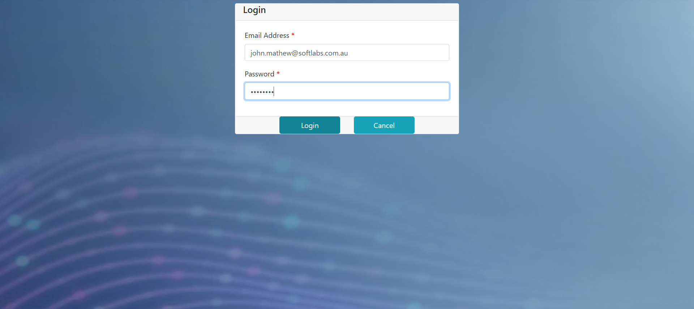
Login
john.mathew@gmail.com
- Use email ID and password given for this timesheet application

Slide 4
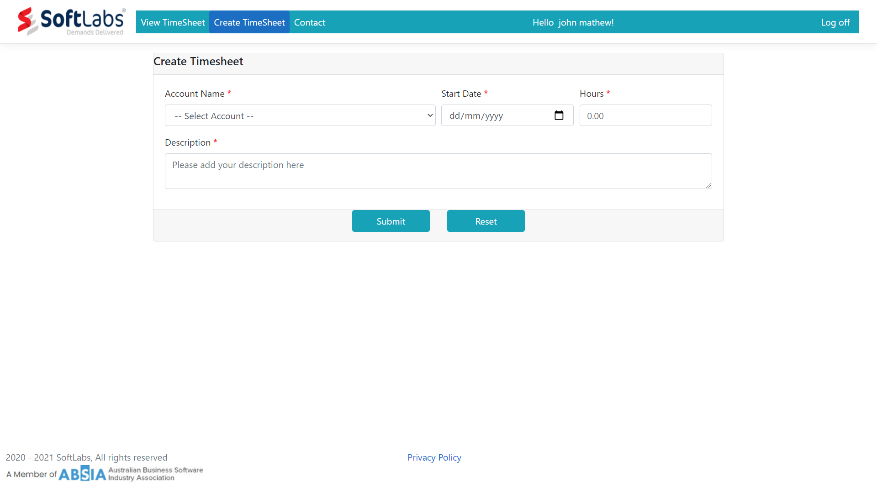
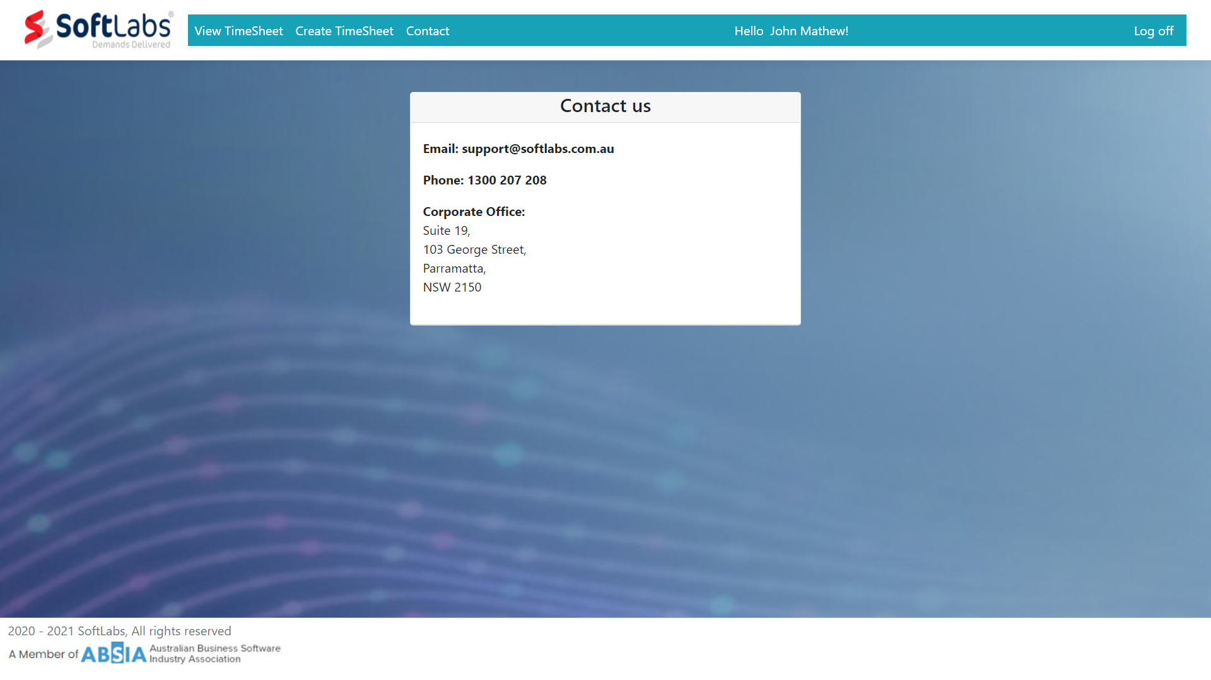
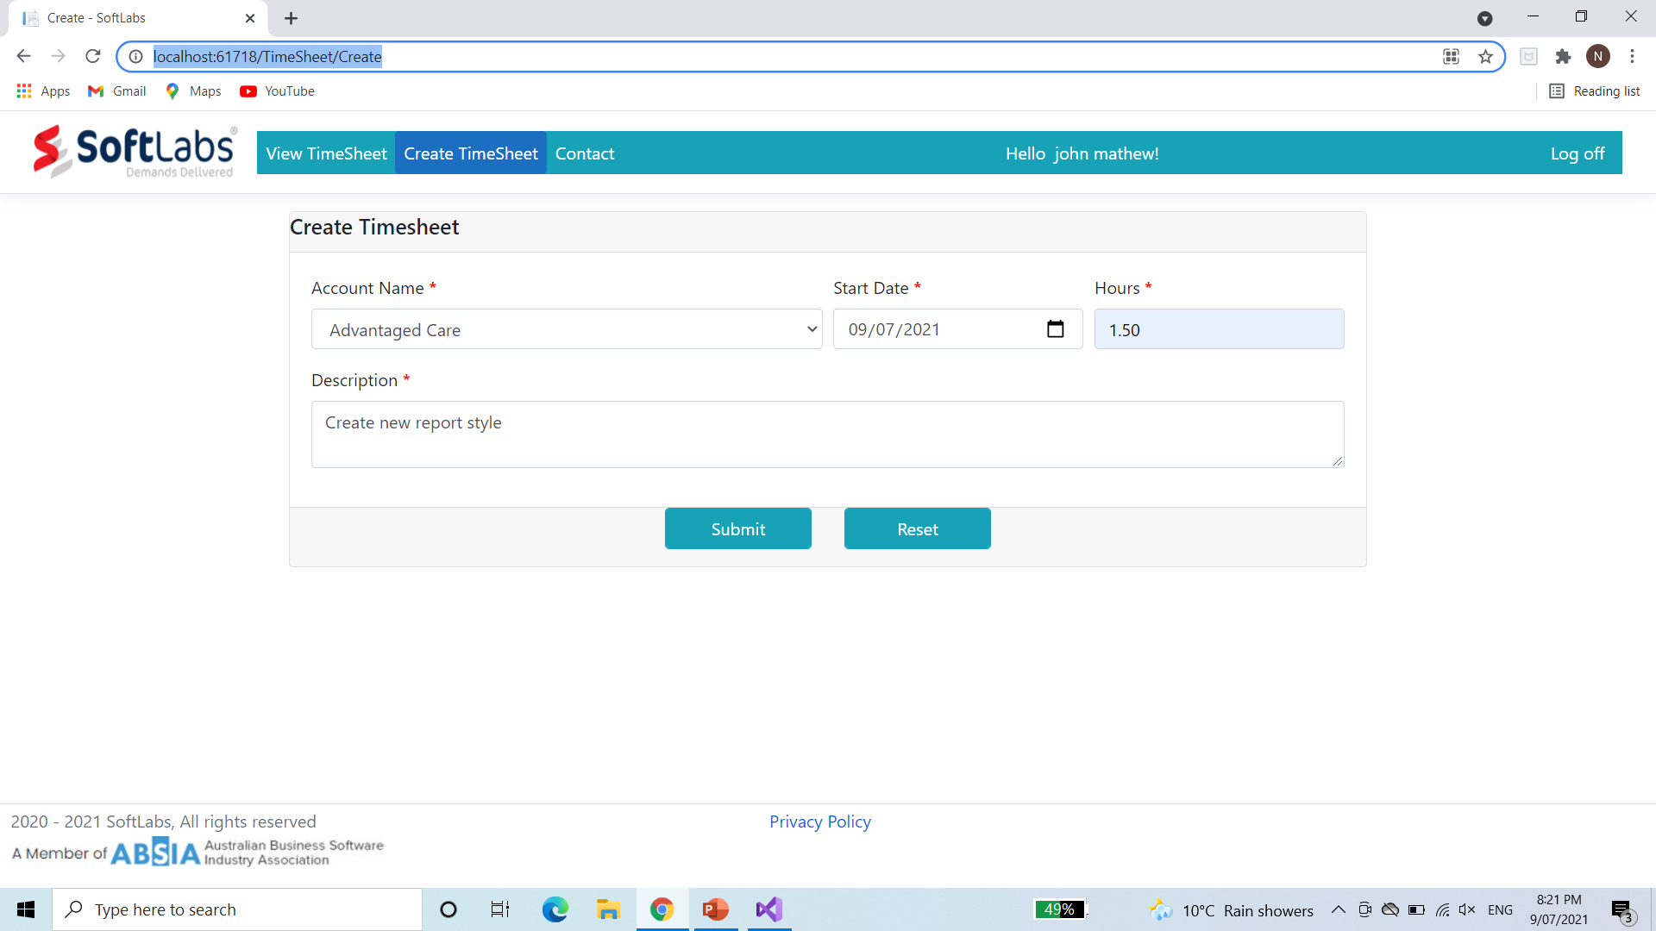
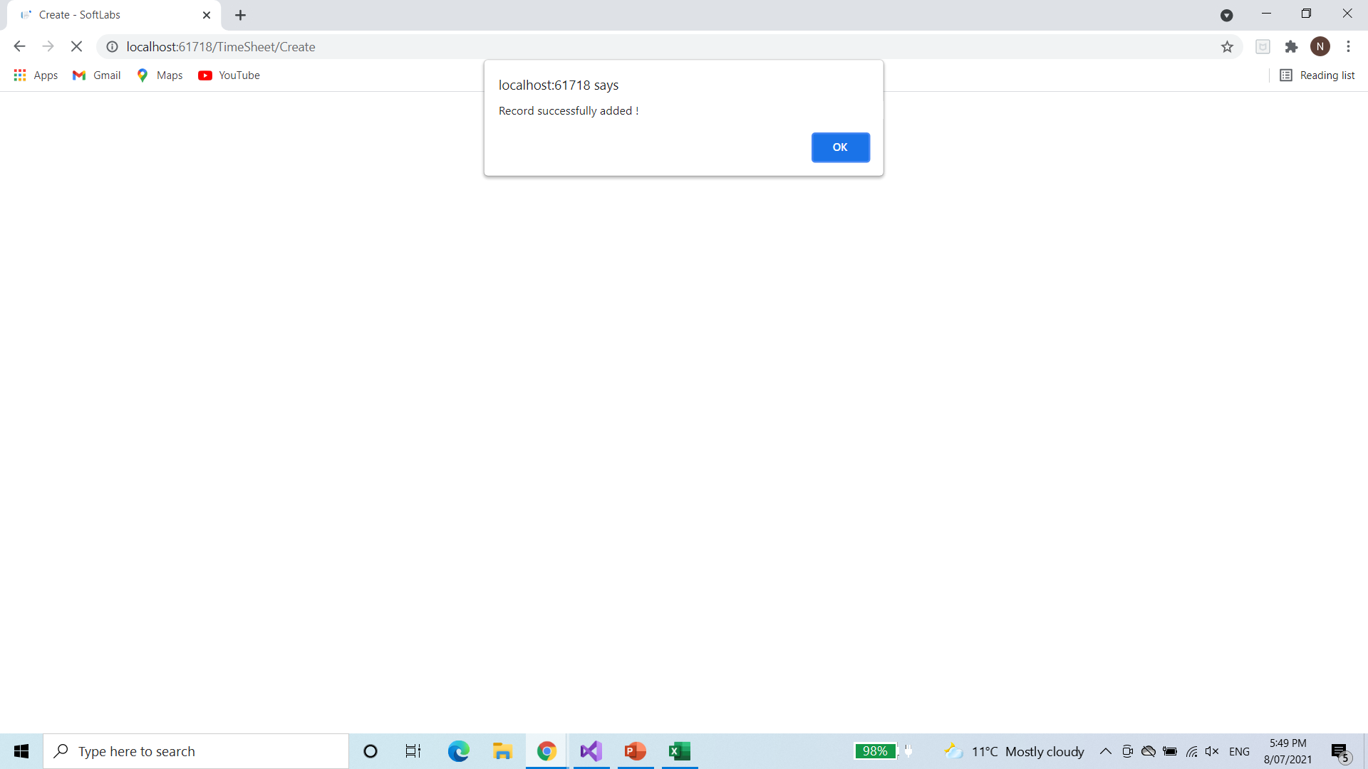
Create TimeSheet
2
2
1
1
Click on Create TimeSheet menu
Enter the time sheet details:
- Select Account Name and Start Date
- Enter Hours and Description
Click on Submit button to save the record.
‘Record Successfully added’ pop-up will be shown.
- User can create any number of records.
- All the submitted records are available under View TimeSheet menu.
Click on Reset button to clear the fields
1
2
2
3
3
5
4
4
5

Slide 5
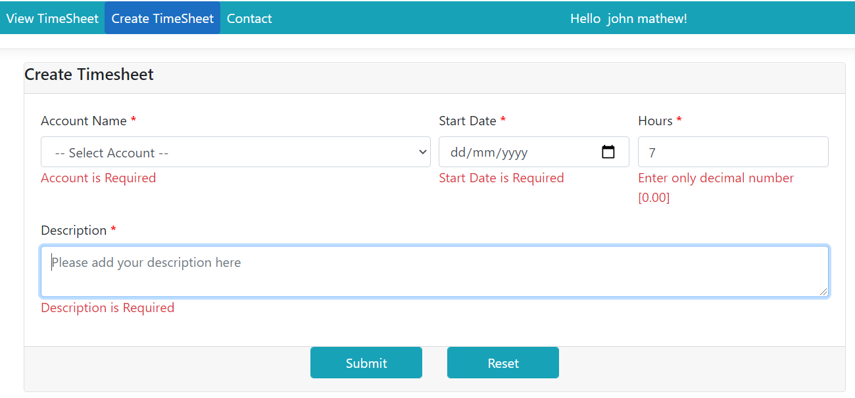
Create TimeSheet
- All the fields are mandatory
- Hours must be in decimal format [Eg: 7.00, 2.30, …]
- Description should be within 250 characters.

Slide 6
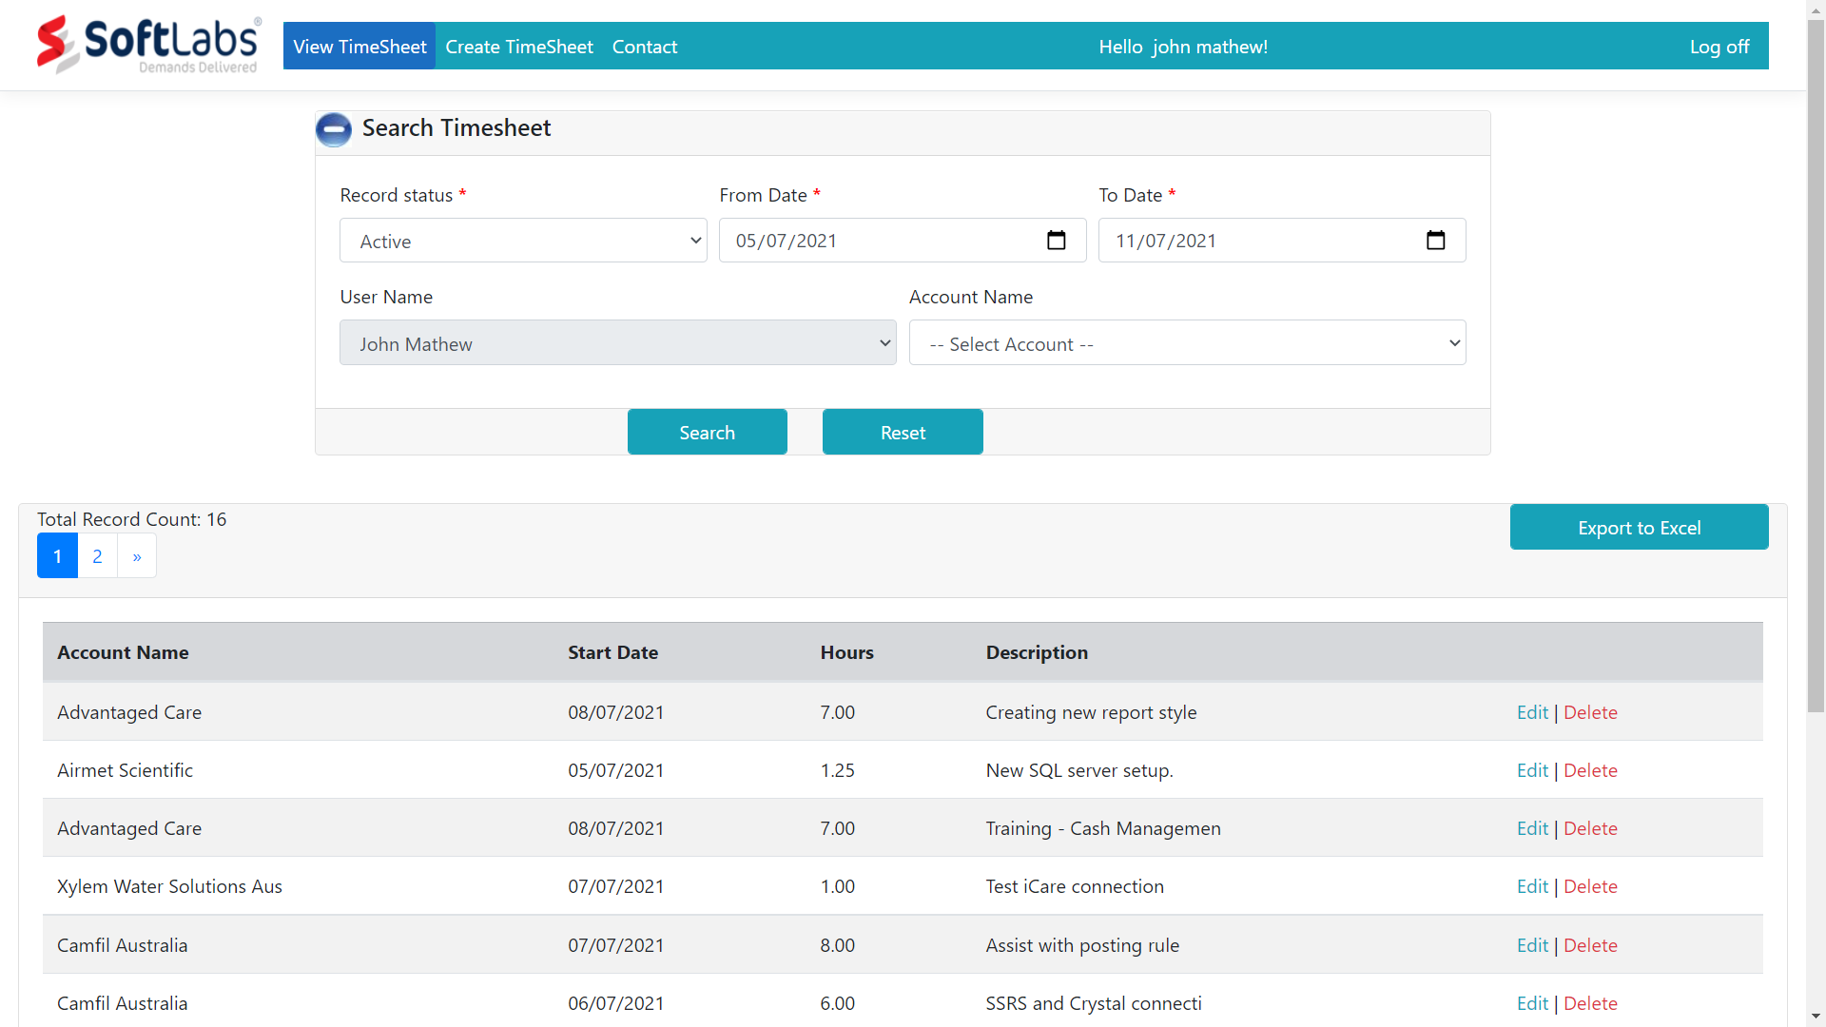
View TimeSheet
1
2
1
Click on View TimeSheet menu
By default Active records for the current week Monday to Sunday will be displayed.
Records can be searched based on:
- Records Status: Active, Locked or Archive
- Record created date: Date range should be less than 60 Days.
- Optional Account wise filter can also be done.
Reset to default search settings.
2
3
4
3
4

Slide 7
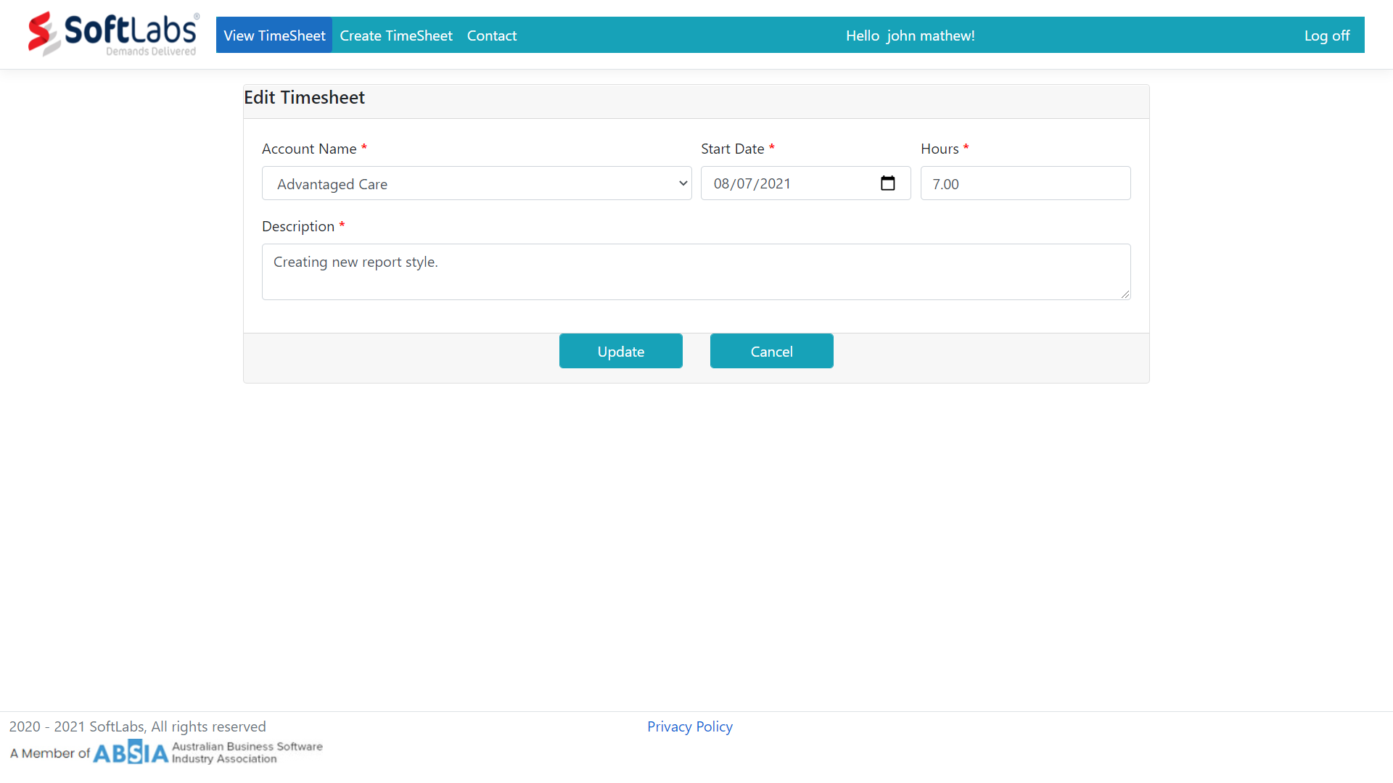
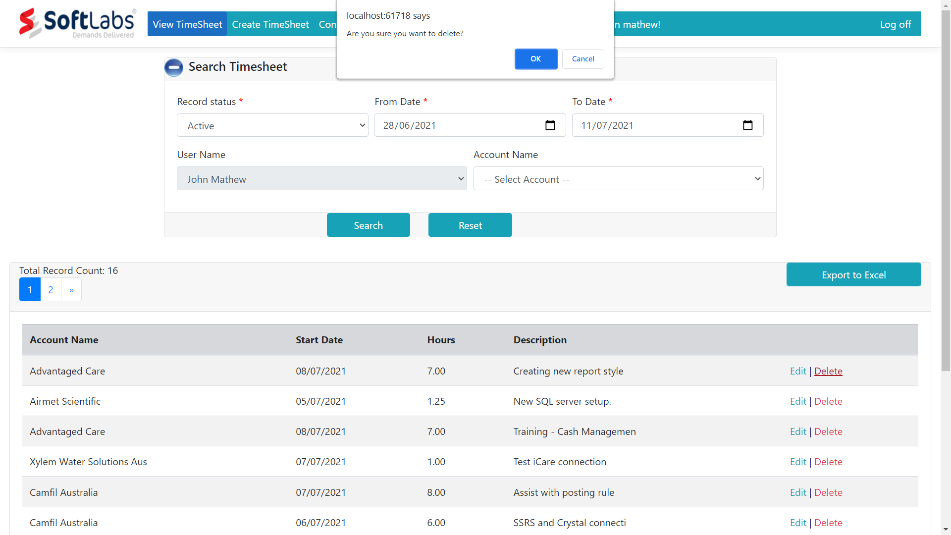
Record status: Active - Edit / Delete
1
2
3
- Active: Records that are still in process. Users can edit or delete on these records.
- Edit Link: Selected record will be open in an editable format. User can perform changes and update the record.
- Delete Link: Remove the selected record from the system.
1
2
3

Slide 8
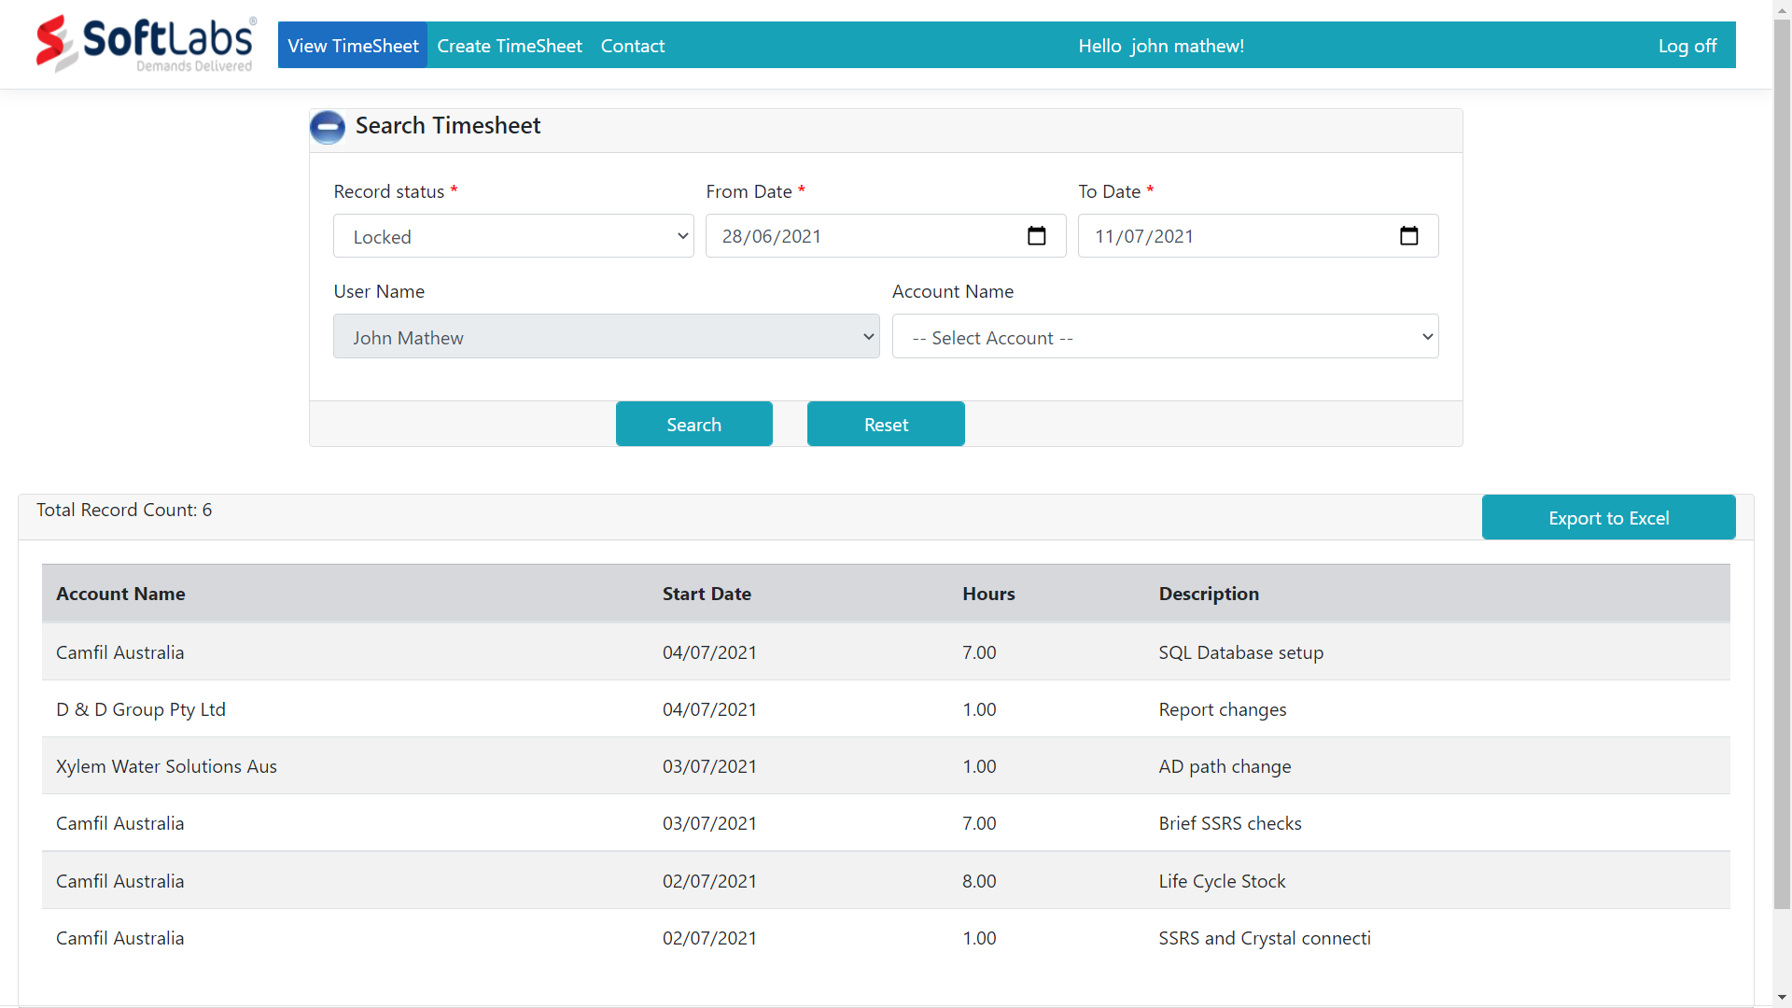
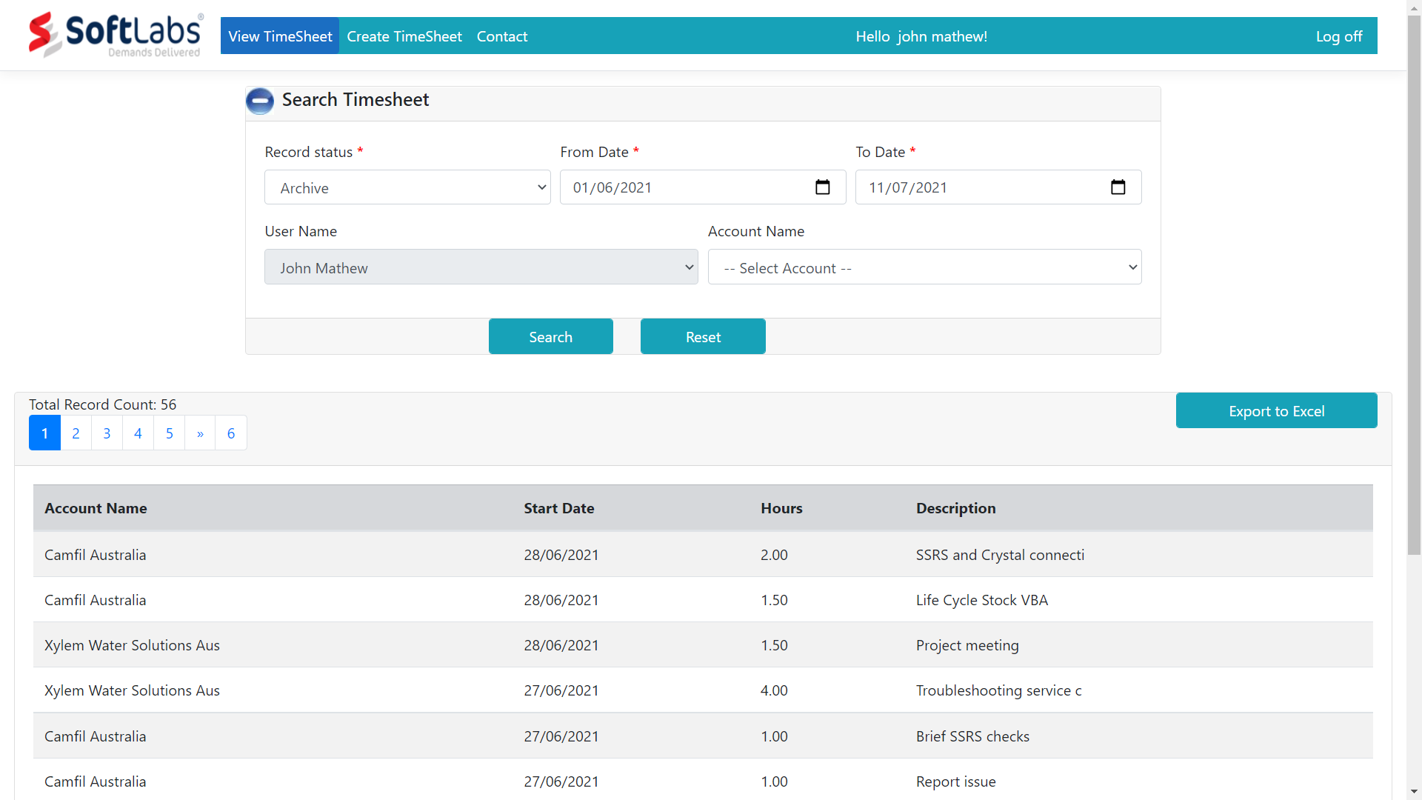
Record status: Locked Record status: Archive
1
2
- Locked: Admin started processing the records
- Select ‘Locked’ under search Record status
- For any modifications on locked record, contact Admin to unlock the record.
- Once Admin Unlocked, the record will be displayed under the Active record status for modification.
1
2
- Archive: Old records that are processed
- Select ‘Archive’ under search Record status

Slide 9
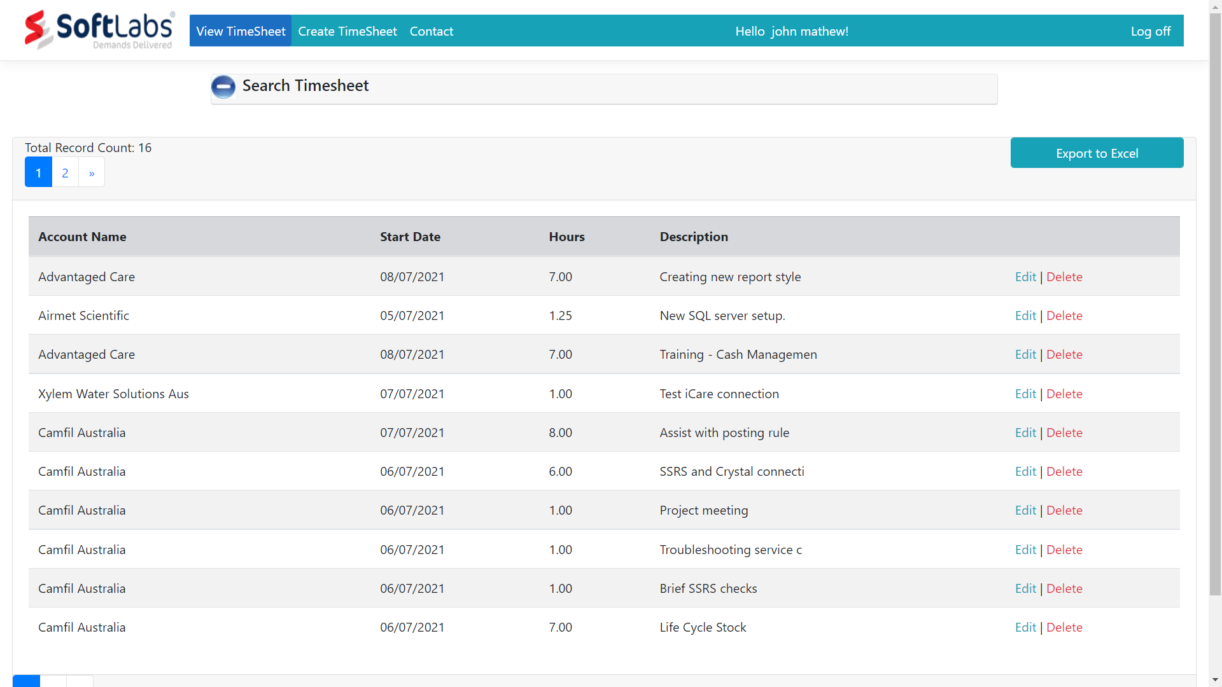
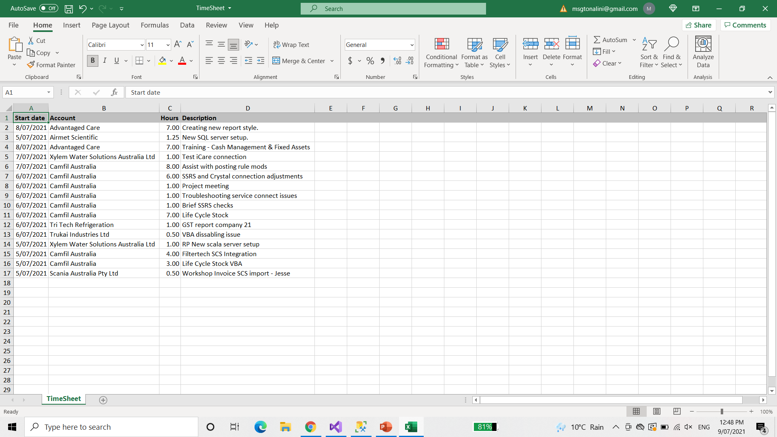
View TimeSheet: Features
1
3
2
- Collapse button: To toggle the Search panel for viewing more records.
- Page navigation: To fetch more records.
- ‘Export to excel’ button: To download the filtered records in to your system.
1
1
2
3

Slide 10
Contact
1
john.mathew@gmail.com
- Contact Menu
- Email to Support@telecom.com.au (or) Call on 1300 200 200 for any Timesheet related queries.
1
711-2880 Nulla St.
Mankato Mississippi 96522

Slide 11
Thank you !

